Slide 1
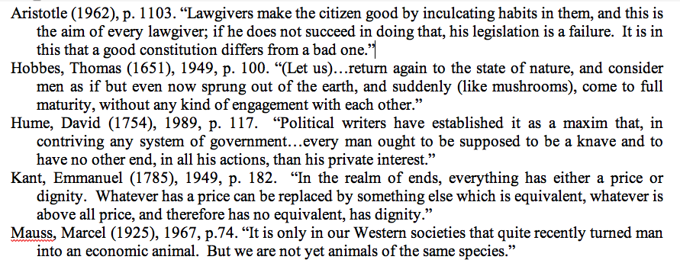
Evolutionary Observations on Political Legitimacy

Slide 2
Standard Models in Political Science

Slide 3
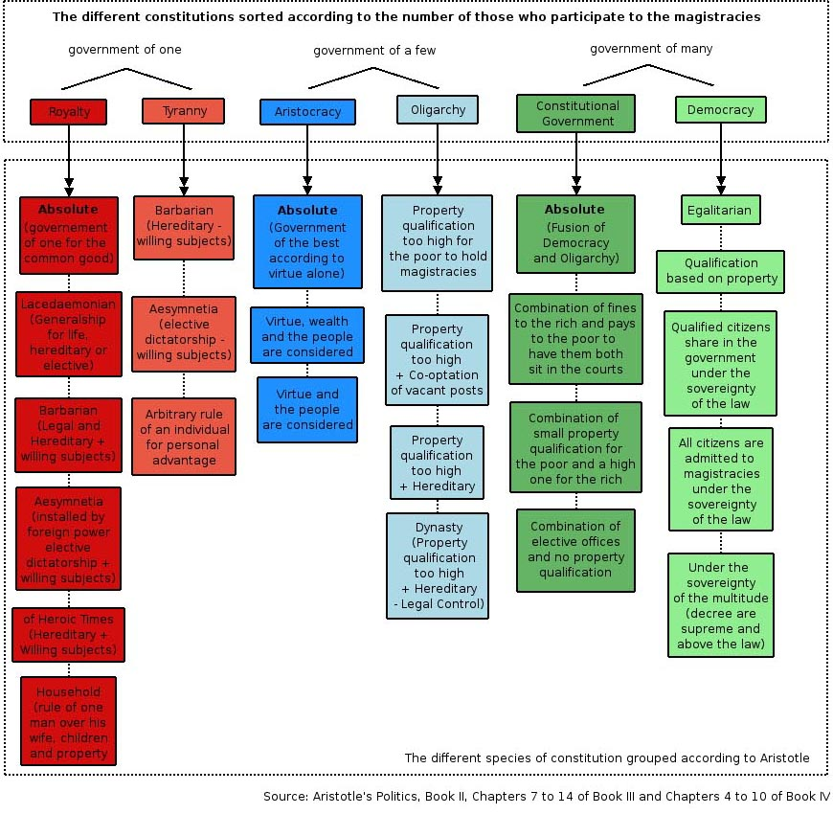
Aristotle’s Constitutional Configurations

Slide 4
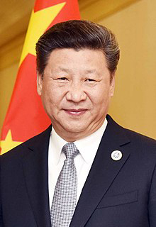
Democracy at Risk - 2
1.
2.
3.
4.
5.

Slide 5
Democracy At Risk - 1

Slide 6
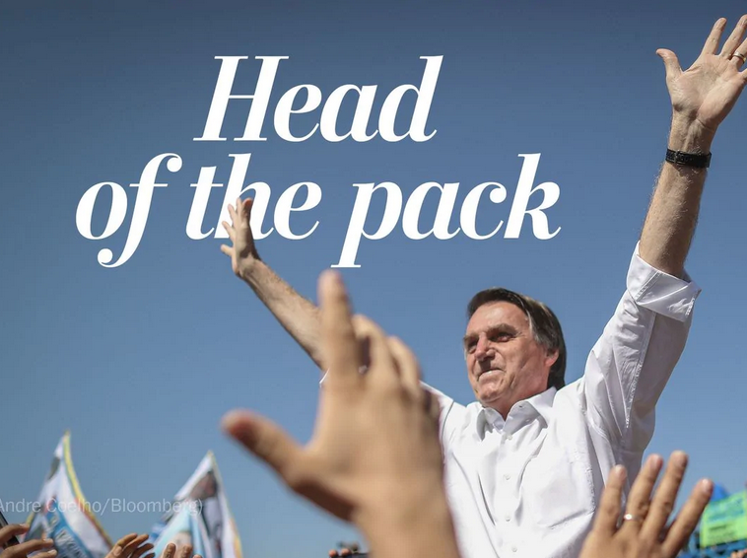
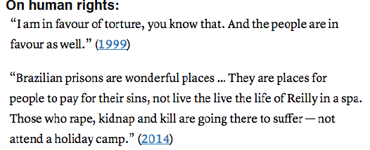
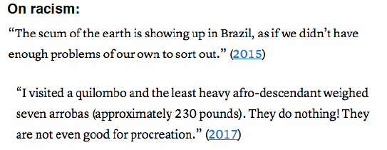
Democracy at Risk -3
1.
2.
3.

Slide 7
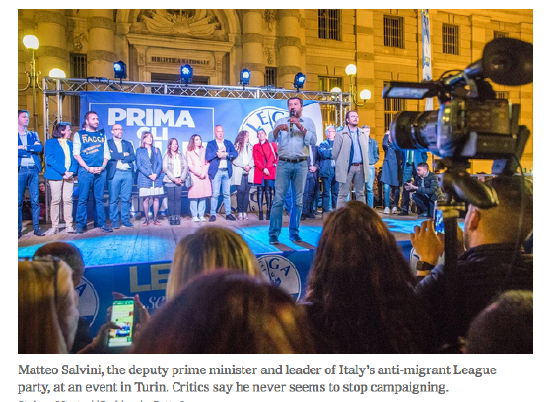
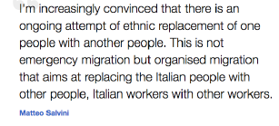
Democracy at Risk - 4

Slide 8
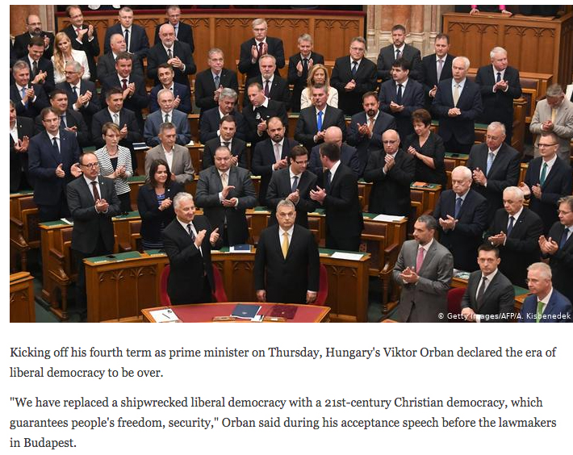
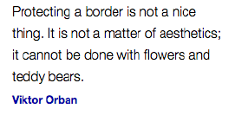
Democracy at Risk - 5

Slide 9
Democracy at Risk - 6
On Kim Jon Un: “Great personality and very smart. Good combination. I learned he’s a very talented man. I also learned he loves his country very much.”
“Why are we having all these people from shithole countries come here?”
“The media is – really, the word, I think one of the greatest of all terms I’ve come up with – is fake.”
1917 01 15 “NATO is obsolete because it isn’t taking care of terror”
1917 01 15 “I will built a great wall, and nobody builds walls better than me, believe me, and I’ll build it inexpensively. I will build a great wall on our southern border, and I’ll have Mexico pay for that wall.”
“When Mexico sends its people, they not sending their best. They’re not sending you. They’re not sending you. They’re sending people that have lots of problems, and they’re bringing those problems with us. They’re bringing drugs. They’re bringing crime. They’re rapists. And some, I assume, are good people.”

Slide 10
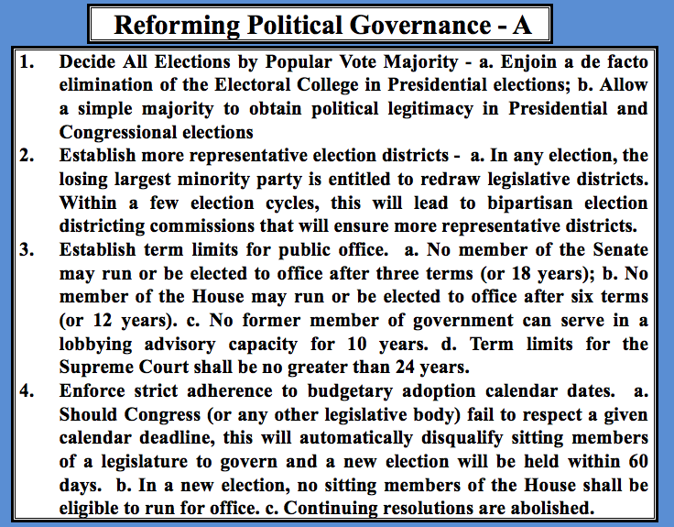
Affirming Political Legitimacy - 01

Slide 11
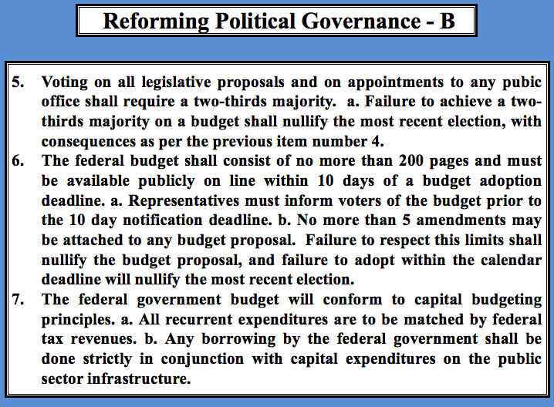
Affirming Political Legitimacy - 02

Slide 12
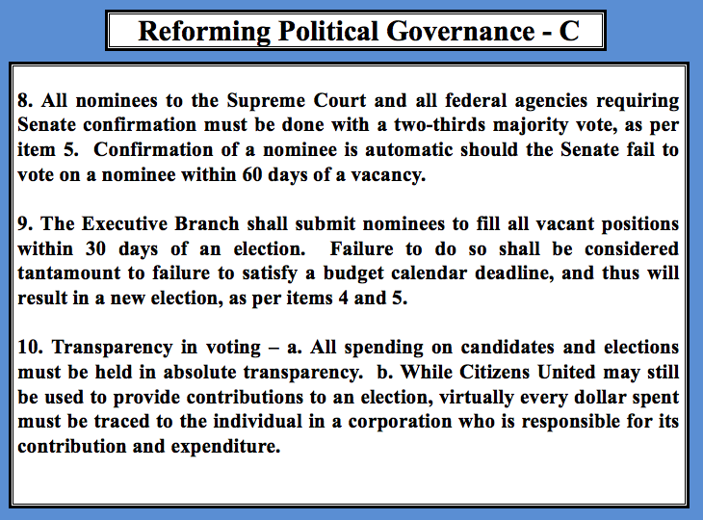
Affirming Political Legitimacy - 03

Slide 13
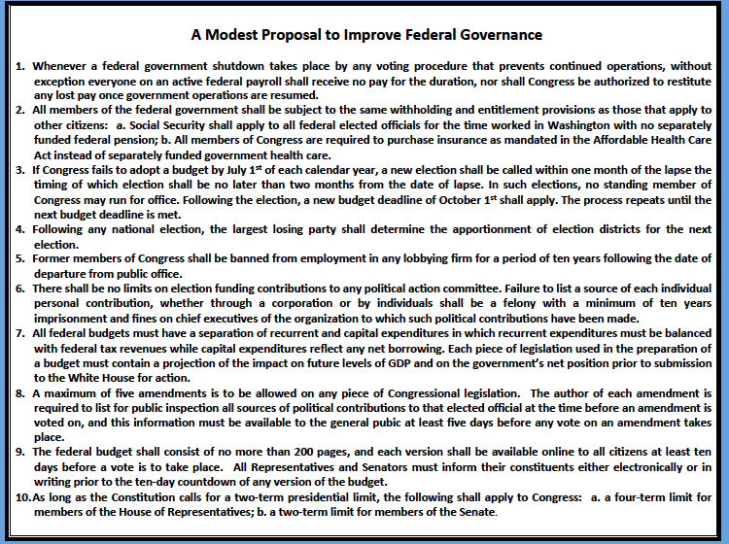
Affirming Political Legitimacy - 04

Slide 14
Political Legitimacy and the Optimal Size of Government

Slide 15
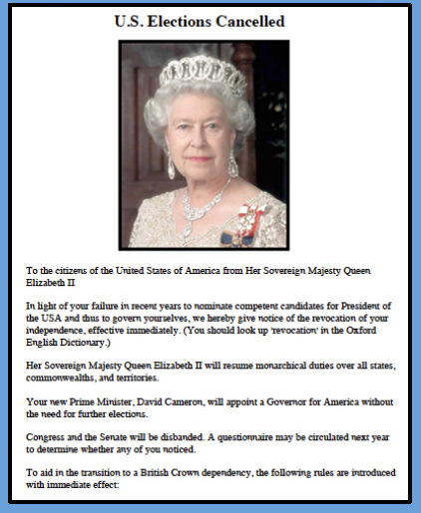
The Alternative to Existing Political Legitimacy

